Slide 1
Li- ion modeling physics-based
Dongmyung Suh

Slide 2
Design of Li ion battery simulation Model
Physics based Li-ion cell model requires considering thermodynamics, mass/charge transfer, electrochemical reaction
Spectral Element Method as numerical method (high numerical accuracy and stability)
Powell hybrid method is applied to solving the system of non-linear algebraic equations.
Simulation should be transient following charging/discharging cycle.
Calculation time step size is self- adjustable.
Post-processing module to analyze calculation results is also needed.
Simulation package will be used freely without the concerns of license fee.

Slide 3
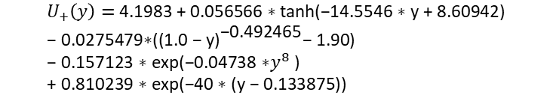

Li-ion battery (Li_{x}C₆ | Li _{y}Mn₂O₄)
Negative Electrode
Li_{x}C₆ ⇄ x Li⁺ + x e⁻ + C₆
$$U_{−}\left(x\right) \text{=} \text{−0.16 + 1.32 ∗ }\text{np}\text{.}\text{exp}\text{(−3.0 ∗ }\text{x}\text{) + 10.0 ∗ }\text{np}\text{.}\text{exp}\text{(−2000.0 ∗ }\text{x}\text{)}$$
Positive Electrode
y Li⁺ + y e⁻ + Mn₂O₄ ⇄ Li _{y}Mn₂O₄
$$U_{+}\left(y\right) \text{= }\text{4.1983 + 0.056566 ∗ }\text{tanh}\text{(−14.5546 ∗ }\text{y}\text{ + 8.60942) } \\ \text{− 0.0275479∗(}{\text{(1.0 − }\text{y}\text{)}}^{\text{−0.492465}}\text{− 1.90) } \\ \text{− 0.157123 ∗ }\text{exp}\text{(−0.04738 ∗}y^{8}\text{ ) } \\ \text{+ 0.810239 ∗ }\text{exp}\text{(−40 ∗ (}\text{y}\text{ − 0.133875))}$$

Slide 4


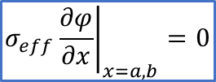


Physics Based Model of Li-ion battery
- in Electrode (Negative/Positive)
- Conservation of Charge
$$φ\left(x=0\right)=0 V$$
Li _{y}Mn₂O₄
$${σ_{eff}\left.\frac{∂φ}{∂x}\right|}_{x=a,b}=0$$
$${σ_{eff}\left.\frac{∂φ}{∂x}\right|}_{x=L}=J=\frac{I}{A}$$
a
b
- Conservation of Mass
$${\left.\frac{∂C_{s}}{∂r}\right|}_{r=0}=0$$
$${\left.−D_{s}\frac{∂C_{s}}{∂r}\right|}_{r=R}=\frac{j_{Li}}{a_{s}F}$$
a_{s} : specific area per unit volume

Slide 5
- in Electrolyte
- Conservation of Charge
- Conservation of Mass

Slide 6
Electrochemical Reaction
Butler-Volmer Kinetic Equation
(a) Charging
(a) Discharging

Slide 7
Spectral Element Method (SEM)
High-Order FEM
Lagrange polynomials as interpolating functions.
Combined with interpolation scheme based on the Gauss-Lobatto-Legendre (GLL) collocation points
High Accuracy, Fast Converging and easy to parallelizing.

Slide 8
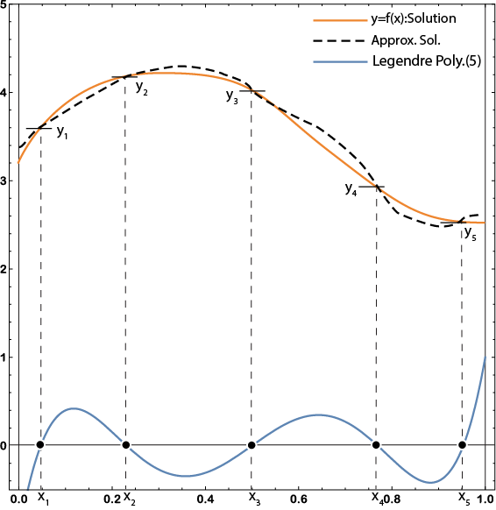
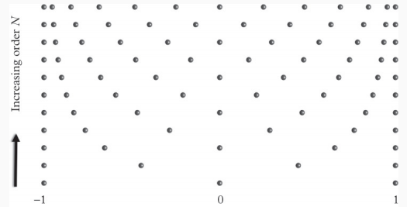
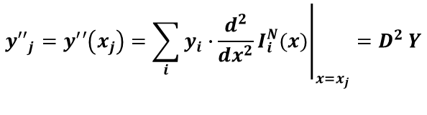

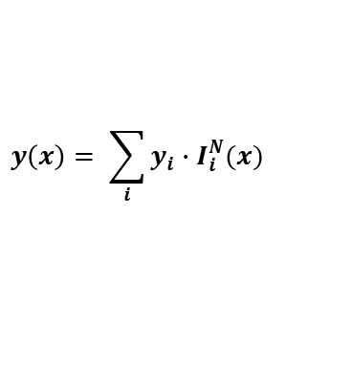
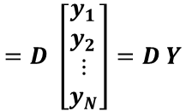
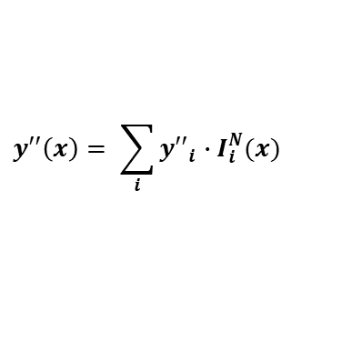

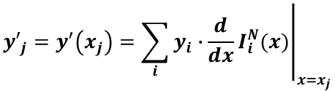
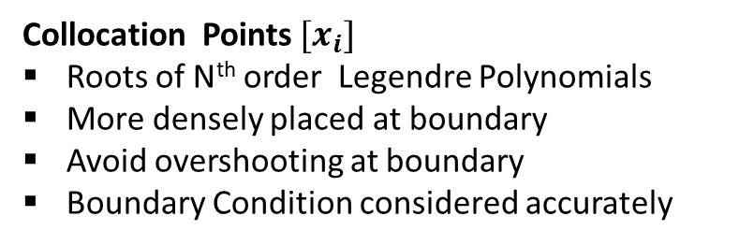
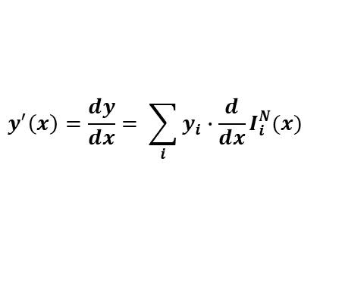
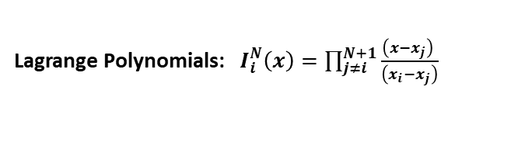
$$y\left(x\right)= \sum_{i}{y_{i}∙I_{i}^{N}(x)}$$
Lagrange Polynomials: $I_{i}^{N}\left(x\right)=\prod_{j≠i}^{N+1}{\frac{\left({x−x}_{j}\right) }{\left(x_{i}−x_{j}\right)}}$
$$I_{i}^{N}\left(x_{j}\right)=δ_{i,j}$$
$$y^{′}\left(x\right)=\frac{dy}{dx}= \sum_{i}{y_{i}∙{\frac{d}{dx}I}_{i}^{N}(x)}$$
$${y′}_{j}=y^{′}\left(x_{j}\right)={\left.\sum_{i}{y_{i}∙{\frac{d}{dx}I}_{i}^{N}(x)}\right|}_{x=x_{j}}$$
$$=D \left[\begin{matrix}y_{1} \\ y_{2} \\ \begin{matrix}⋮ \\ y_{N}\end{matrix}\end{matrix}\right]=D Y$$
D (5th Order) =
$${y′′}_{j}=y^{′}′\left(x_{j}\right)={\left.\sum_{i}{y_{i}∙{\frac{d^{2}}{dx^{2}}I}_{i}^{N}(x)}\right|}_{x=x_{j}}=D^{2} Y$$
$$y′′\left(x\right)= \sum_{i}{{y′′}_{i}∙I_{i}^{N}(x)}$$
Collocation Points $[x_{i}]$
Roots of N^{th} order Legendre Polynomials
More densely placed at boundary
Avoid overshooting at boundary
Boundary Condition considered accurately
Differential Equation ⇒ Algebraic Equation
$$α\frac{d^{2}y}{dx^{2}}+β\frac{dy}{dx}+γy = \left(αD^{2}+βD+γI\right) Y ⇒ M Y$$

Slide 9
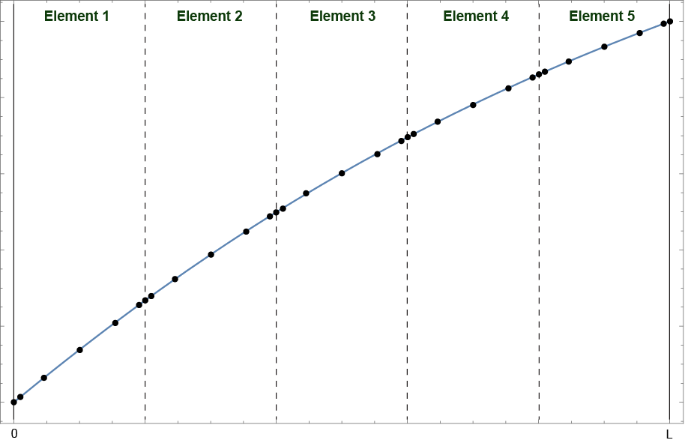


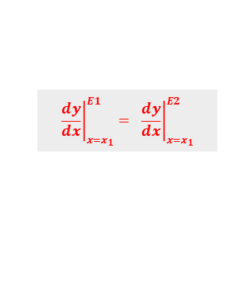
Global Matrix (G ) in SEM
Assemble each element’s Matrix(M) into a global Matrix (G)
using continuity at boundaries between elements
M₁ for Element 1
$${\left.\frac{dy}{dx}\right|}_{x=x_{1}}^{E1}= {\left.\frac{dy}{dx}\right|}_{x=x_{1}}^{E2}$$
M₂ for E 2
$G$=
M₃
M₄
M₅
$$x_{1}$$
Spectral elements and collocation points
Matrix Structure for SEM

Slide 10
Solving the system of Non-linear Algebraic Equations
Linear Differential Equations
$$α\frac{d^{2}y}{dx^{2}}+β\frac{dy}{dx}+γy = \left(αD^{2}+βD+γI\right) Y =M Y = Constants$$
numpy.linalg.solve(M, Constants)
Non-Linear Differential Equations
$$α\frac{d^{2}y}{dx^{2}}+β\frac{dy}{dx}+γy = \left(αD^{2}+βD+γI\right) Y =M Y =f(Y)$$
scipy.optimize.root( fPM6a, yAll, method="hybr")
Spectral Element Method & Non-linear Solver were implemented in Li-ion simulation code (in Python)

Slide 11
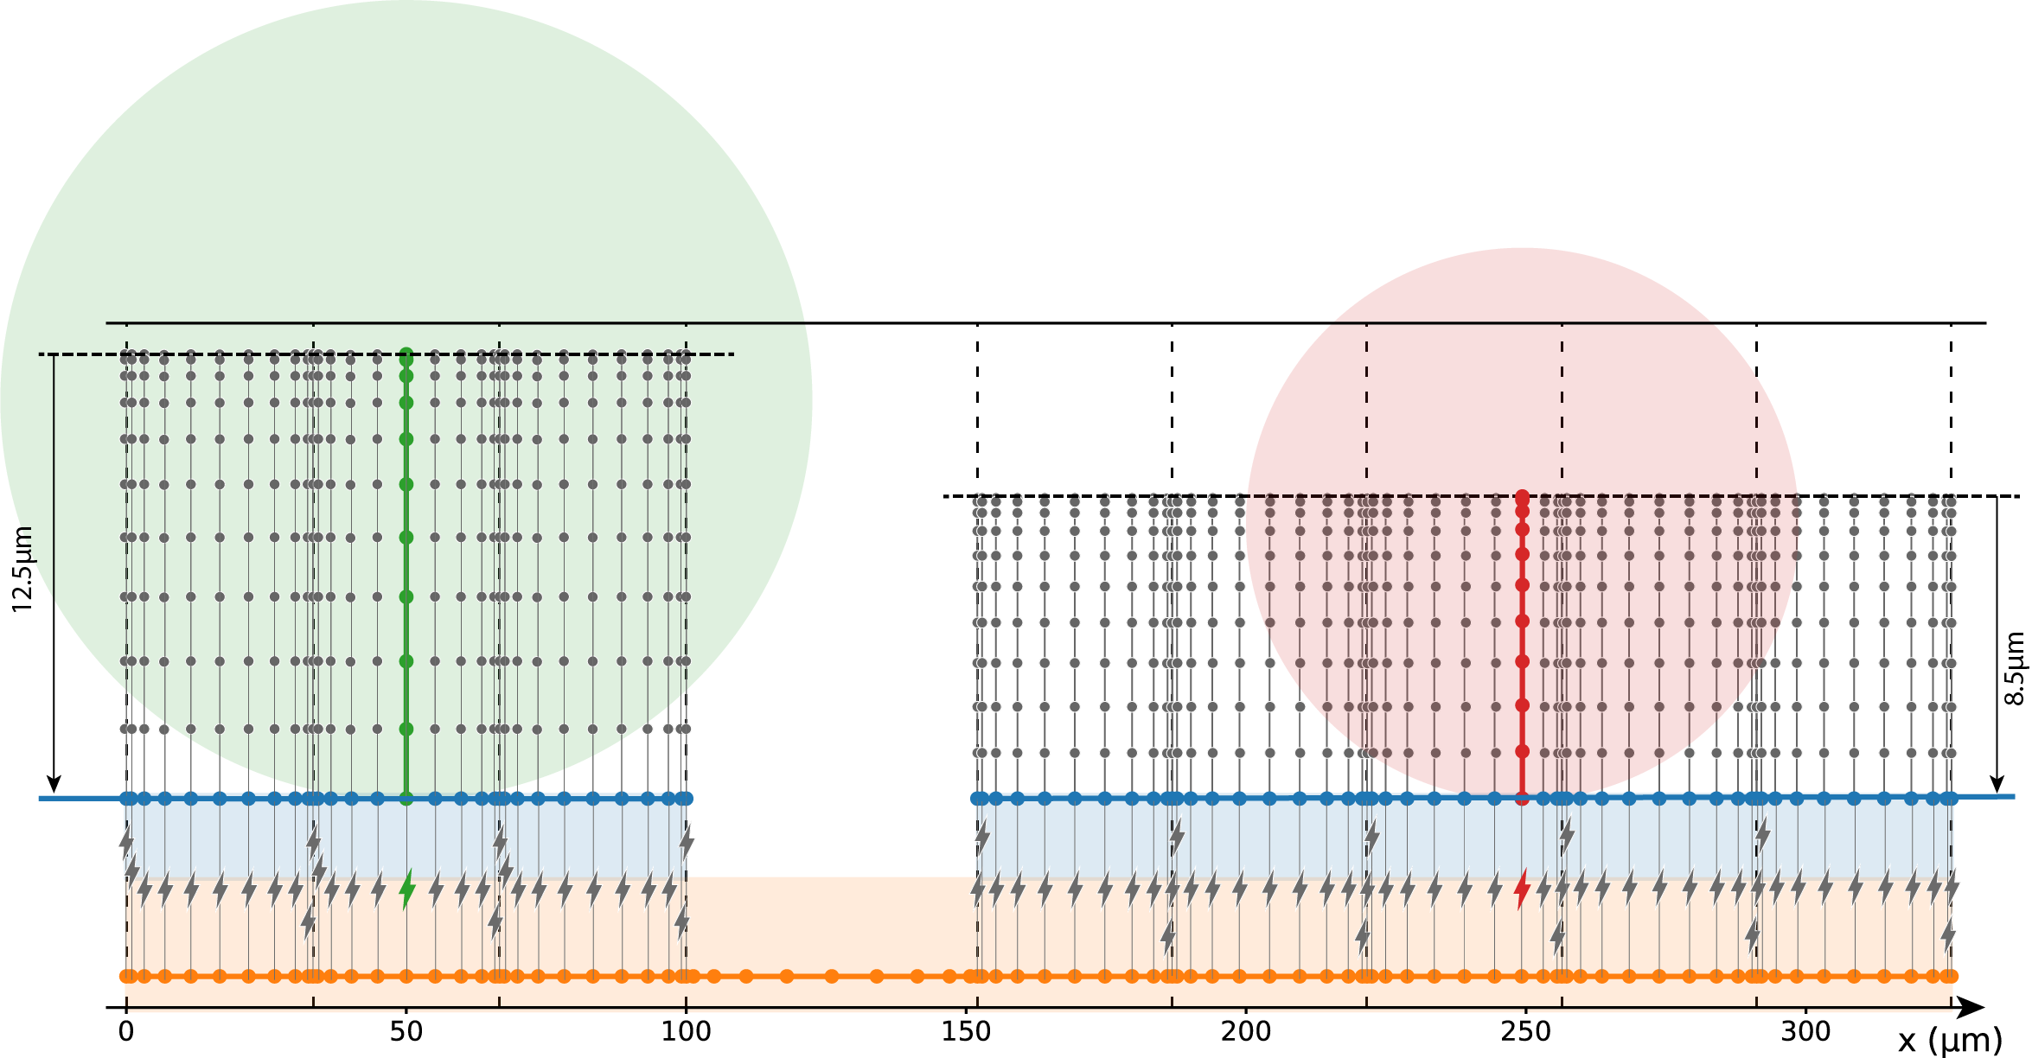
Spectral Elements and Nodes
in Li-ion Model (Pseudo 2D)
particle:
1 Element,
20th order
-
Negative Electrode:
3 Elements,10th order
Positive Electrode:
5 Elements, 10th order
+
particle
1 Element,
20th order
Electrolyte:
9 Elements, 10th order
$j_{Li}=i_{0}[exp⁡(−\frac{αF}{RT}η−j_{Li}\frac{R_{SEI}}{a})−exp⁡(\frac{(1−α)F}{RT}η−j_{Li}\frac{R_{SEI}}{a})]$

Slide 12
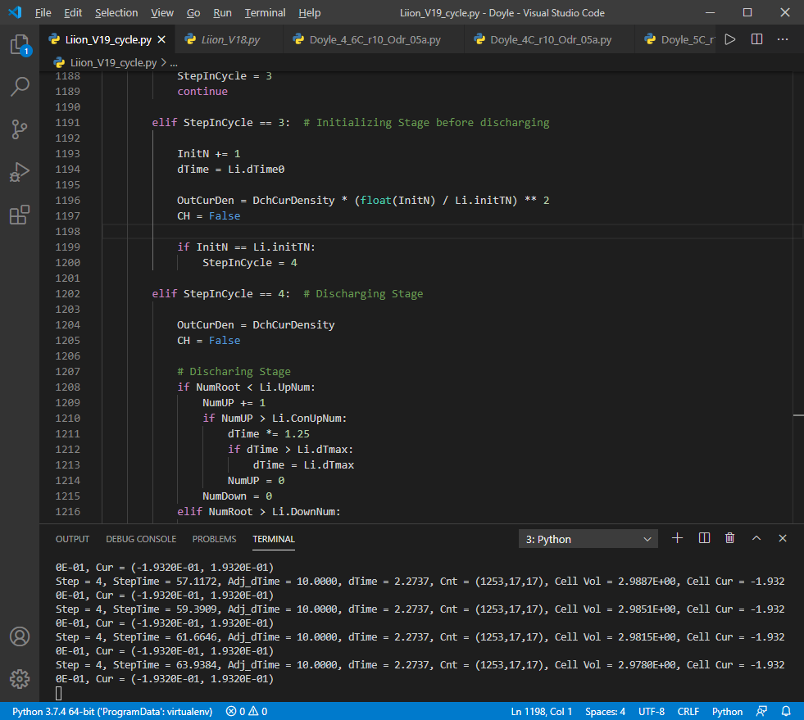
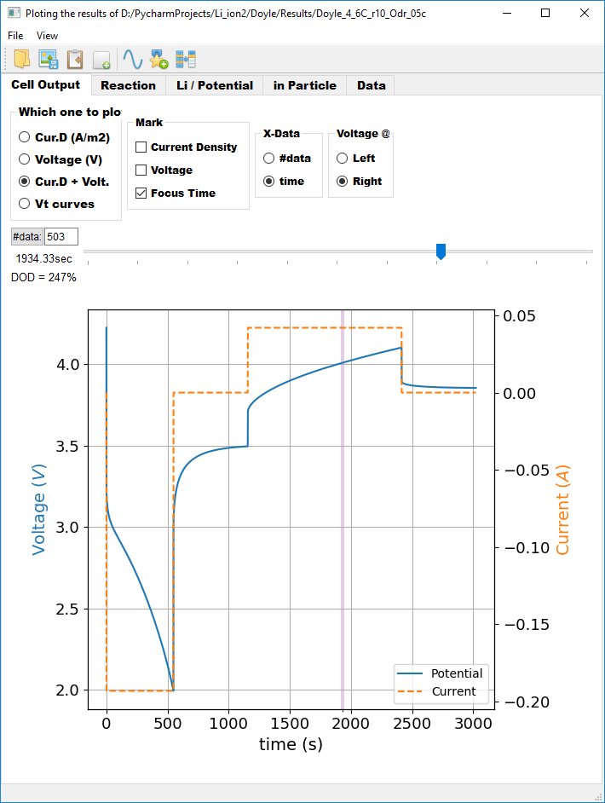
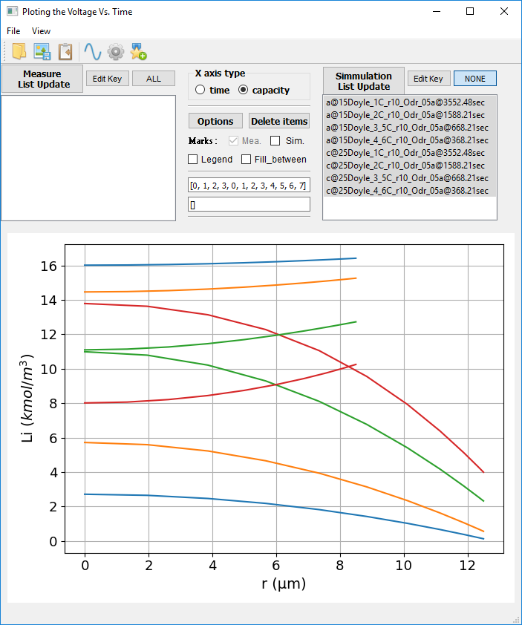
Li-ion battery Simulator & its Postprocessor
Developing the numerical algorithm
Coding simulation & post-processing programs with Python (PyQt5)

Slide 13
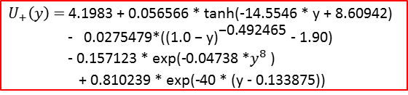

Properties and Parameters
- from Doyle and Newman(1996)
Journal of the Electrochemical Society, 143(6), 1890
$$U_{−}\left(x\right) \text{=} \text{−0.16 + 1.32 ∗ }\text{np}\text{.}\text{exp}\text{(−3.0 ∗ }\text{x}\text{) }$$
$$\text{+ 10.0 ∗ }\text{np}\text{.}\text{exp}\text{(−2000.0 ∗ }\text{x}\text{)}$$
$$U_{+}\left(y\right) \text{= }\text{4.1983 + 0.056566 ∗ }\text{tanh}\text{(−14.5546 ∗ }\text{y}\text{ + 8.60942) }$$
$$\text{−} \text{0.0275479∗}\text{(}{\text{(1.0 − }\text{y}\text{)}}^{\text{−0.492465}}\text{ − 1.90)}\text{ −}\text{ 0.157123 ∗ }\text{exp}\text{(−0.04738 ∗}y^{8}\text{ ) }$$
$$\text{+ 0.810239 ∗ }\text{exp}\text{(−40 ∗ (}\text{y}\text{ − 0.133875))}$$

Slide 14
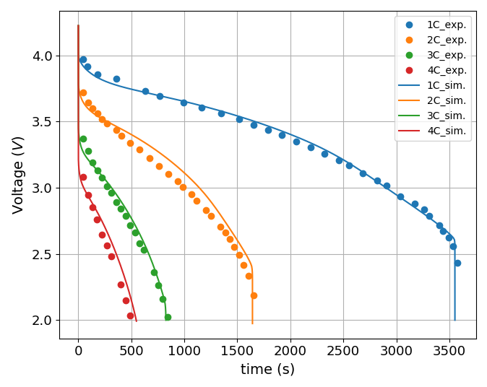
Comparison Simulation Results with Experiments
1C = 17.5 A/m²
Simulating conducted with this model shows a close agreement with test data Doyle & Newman got from Li-Mn₂O₄ battery cell
* exp. data from Doyle, M., & Newman, J. (1996). Comparison of the modeling predictions with experimental data from plastic lithium ion cells. Journal of the Electrochemical Society, 143(6), 1890

Slide 15
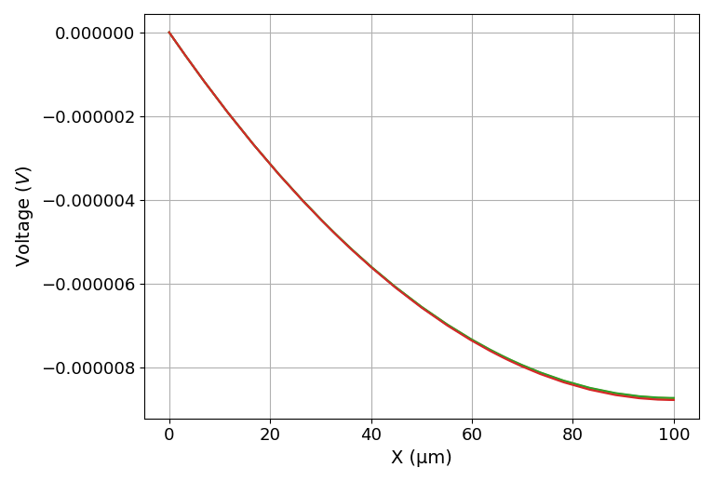
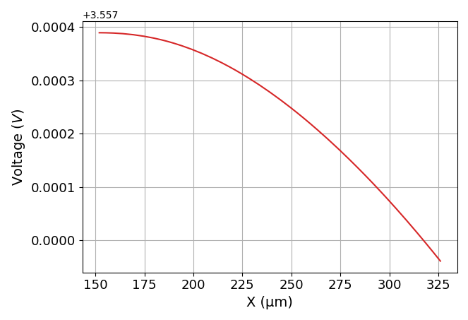
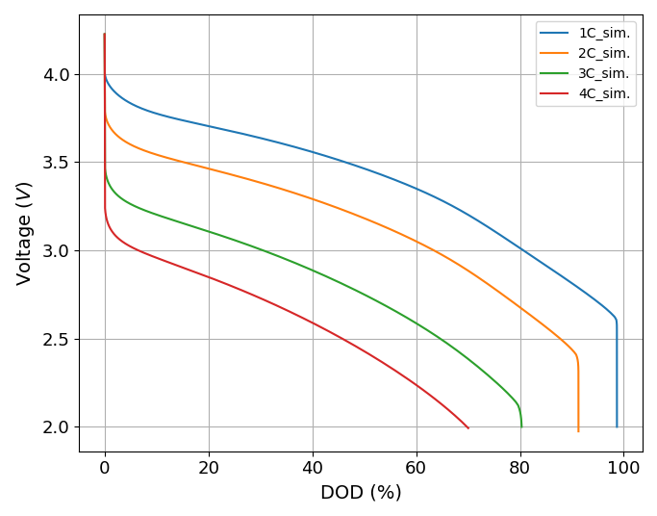
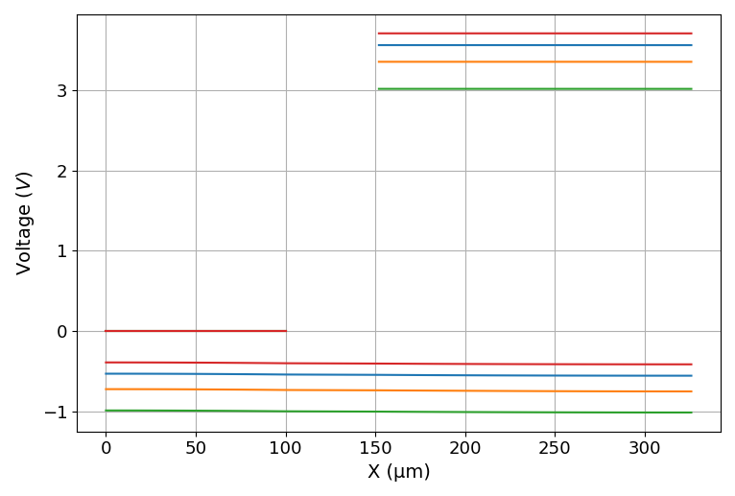




Potential Distribution in Discharging
$$φ=0$$
Neg. Electrode
$$σ_{eff}\frac{∂φ}{∂x}=0$$
Pos. Electrode
$$σ_{eff}\frac{∂φ}{∂x}=J=\frac{I}{A}$$
$$σ_{eff}\frac{∂φ}{∂x}=0$$
1C-20%
1C-40%
1C-60%
1C-20%
1C-80%
1C-40%
1C-60%
Li⁺
1C-80%
100% ⇒17.5Ah/m²
Potential evolution in the cell
in discharging at 1C rate

Slide 16
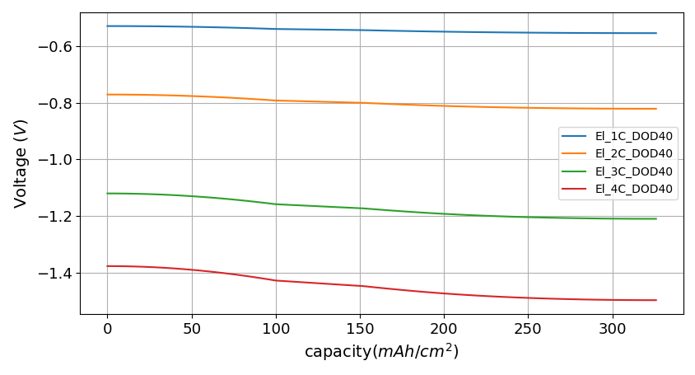
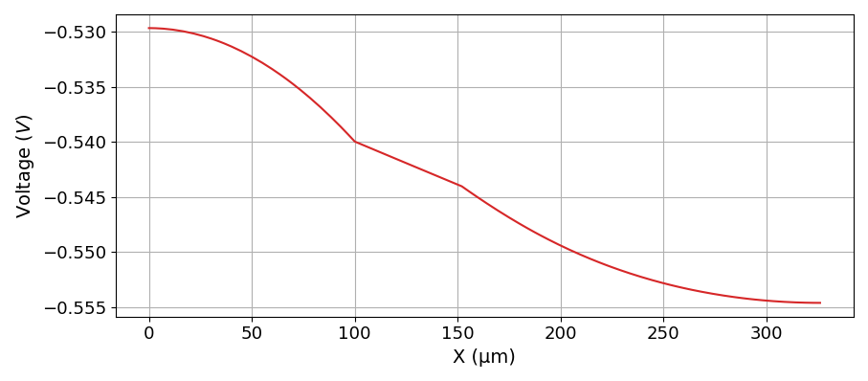


Potential Distribution in Electrolyte
$$σ_{el}\frac{∂φ}{∂x}=0$$
1C-40%
2C-40%
$$σ_{el}\frac{∂φ}{∂x}=0$$
3C-40%
4C-40%
1C discharging at DOD = 20%
Potential distribution

Slide 17
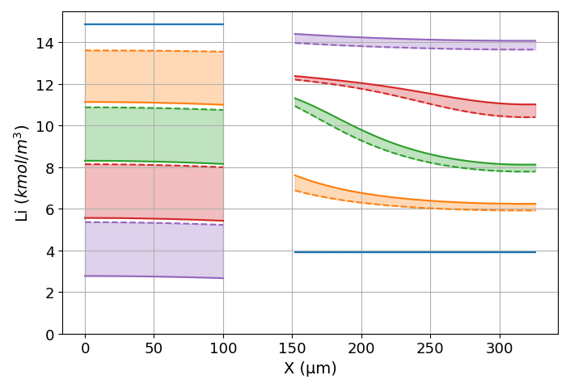
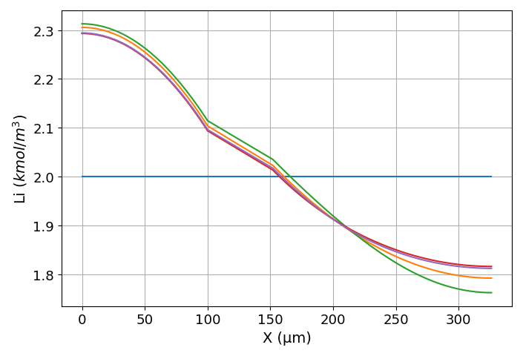
Li concentration distribution ( 1C discharging)
A
In the left figure,
At each DOD condition, Li concentration range is wider in (-) electrode particle than (+) particle.
Along X-direction (the electrode thickness direction), Li concentrations at (+) particle’s surface and center change more than the concentrations of (-) particle.
The reason is because Li ion diffusivity in (-) particle is smaller, but its radius is larger.
Also, thickness (L) of (-) electrode is smaller than that of (+) electrode.
Electrochemical reaction rate changes along X-direction(See the next page).
In the right figure,
Li ion concentration distribution in the electrolyte doesn’t much change with depth of discharge(DOD), if it is discharged under the same rate, here 1C
The average concentration of Li in electrolyte is maintained at the initial value, 2kmol/m³.
D_{el} = 7.5E-11 m²/sec in Electrolyte
(-) Electrode Particle
L₋ = 100 μm
R₋ = 12.5 μm
D₋ = 3.9E-14 m²/sec
(+) Electrode Particle
L₋ = 175 μm
R₊ = 8.5 μm
D₊ = 1.0E-13 m²/sec
0%
80%
20%
60%
80%
40%
40%
60%
40%
20%
60%
Surface
20%
DOD= 0%
Average Li⁺ con.
Center
A
0%
B
DOD =80%
Li concentration distribution in Electrode Particles
Li concentration in Electrolyte

Slide 18
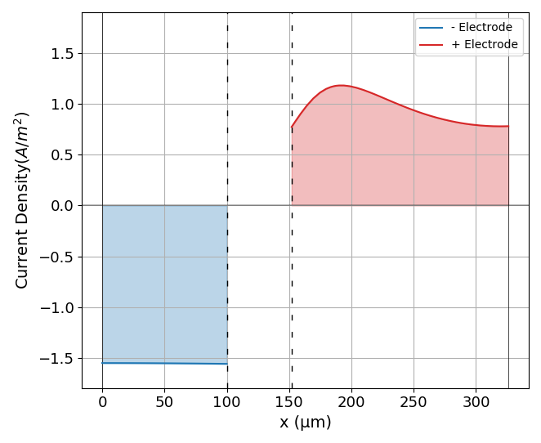
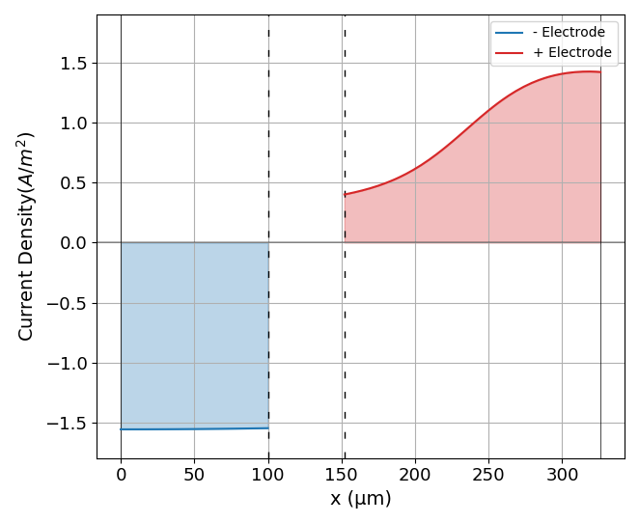
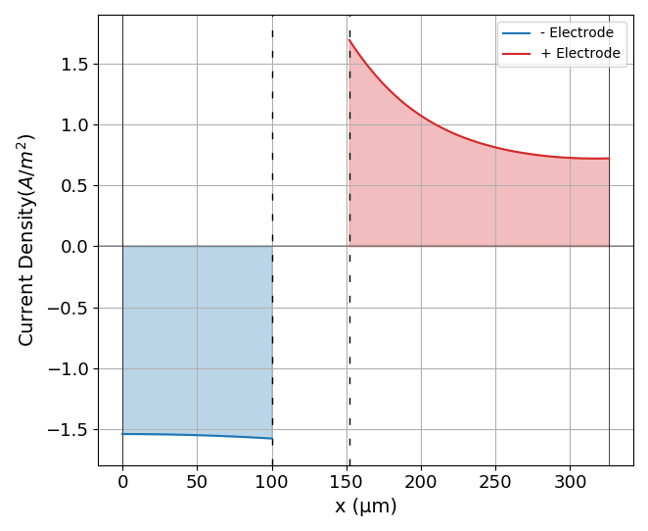
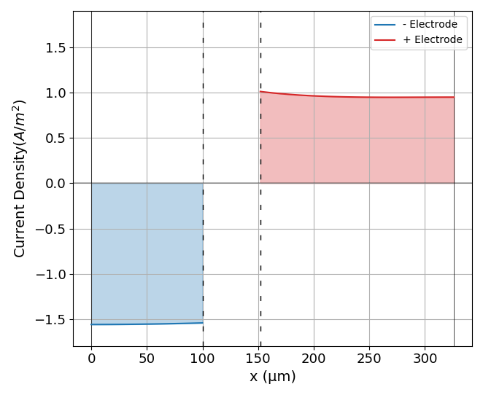


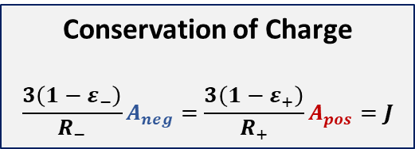
Electrochemical Reactions
Conservation of Charge
$$\frac{3\left(1−ε_{−}\right)}{R_{−}}A_{neg}=\frac{3\left(1−ε_{+}\right)}{R_{+}}A_{pos}=J$$
1C- 40%
$$j_{Li}=i_{0}[exp⁡(\frac{αF}{RT}η)−exp⁡(\frac{−αF}{RT}η)]$$
$$i_{0}=k_{0}{\left(C_{e}\left(C_{s,max}−C_{s}\right)\left({C_{s}−C}_{s,min}\right)\right)}^{0.5}$$
1C- 60%
1C- 20%
A_{pos}
1C- 80%
A
B
A_{neg}

Slide 19
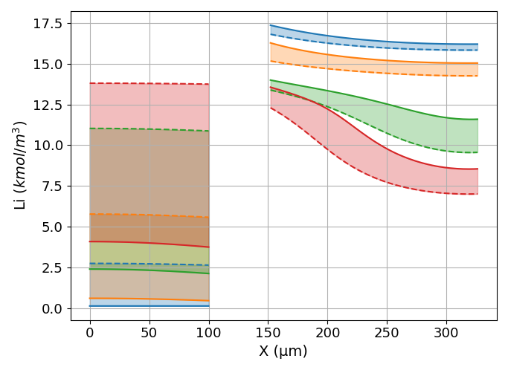
Li⁺ transfer in Electrodes, when cell is discharged to V_{out} = 2.5V
X50
X250
4C-2.5V
3C-2.5V
4C-2.5V
3C-2.5V
2C-2.5V
1C-2.5V
2C-2.5V
1C-2.5V
100% ⇒17.5Ah/m²
As shown in the right figure,
At 1C-2.5V, Li concentration at surface (C_{sur}) has reached its minimum(≈0) at surface.
Due to depletion of Li+, electrochemical reaction is limited and cell output voltage drops quickly.
As discharging get faster than 1C, C_{sur} is higher at V_{out}=2.5V. But voltage drop quickly by internal resistance.
At higher discharging rate condition, C_{Li} range in the electrode particle,|C_{sur} - C_{cen}|, becomes wider at both +/- electrodes.
The range of (+)electrode is narrower than that of (-), because the diffusivity and the particle radius of (+) particle are higher and smaller than (-) electrode.

Slide 20
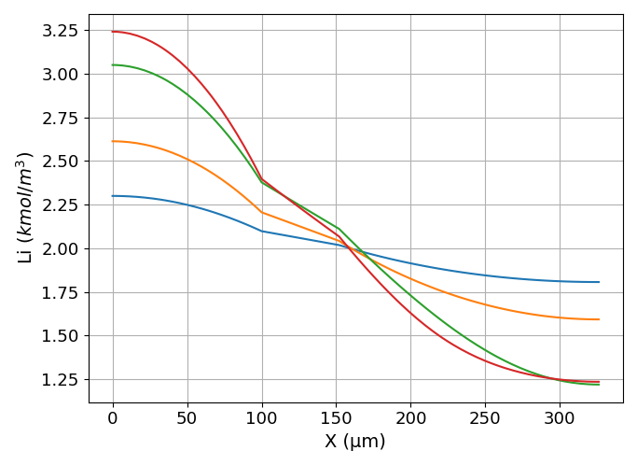
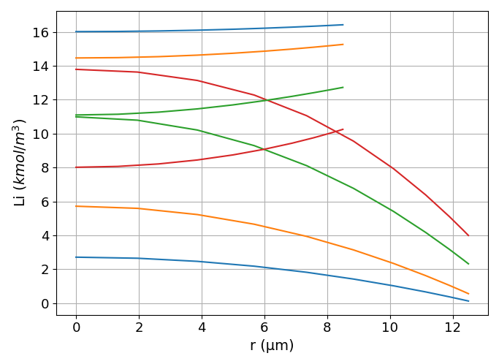


Li concentration
in (+) electrode particle(8.5μm) @ X=50
-4C-2.5V
-4C-2.5V
-3C-2.5V
-3C-2.5V
-2C-2.5V
-2C-2.5V
-1C-2.5V
-1C-2.5V
$$−D_{s}\frac{∂C_{s}}{∂r}=\frac{j_{Li}}{a_{s}F}$$
Average Li⁺ con.
$$\frac{∂C_{s}}{∂r}=0$$
Li concentration
in (-) electrode particle(12.5μm) @ X=250
Li ion concentration in electrolyte at V_{out} = 2.5V
Left figure shows the Li ion concentration in (+)/(-) particle at x=50 and x=250 position
In (+) electrode particle which has smaller size and higher diffusivity, Li concentration range is smaller than in (-) electrode.
The concentration range expands with higher discharging rate.
The cell’s voltage decreases from 4.2V to 2.5V as it discharges at four different rates. During discharging, Li ions in (-) electrode transfer to (+)electrode.
The difference between Li concentration curves of (+)/(-) electrode is larger at lower C-rate (Max. at 1C). That means more Li ions transfer at slower discharging condition; higher discharge capacity.
In the right figure,
As the discharging rate increases, more Li ion transfer through electrolyte from (-) to (+) electrode. And It causes the concentration gradient of Li ion to increase.
However, the average concentration of Li ion is maintained at the initial concentration, 2 kmol/m³.

Slide 21
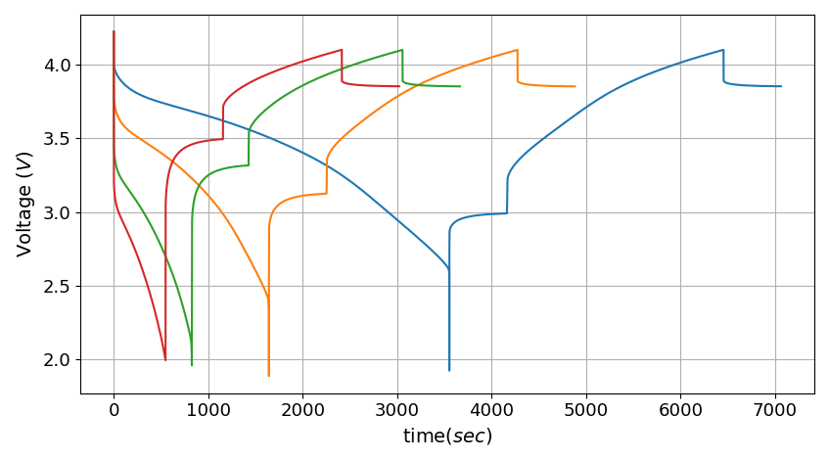
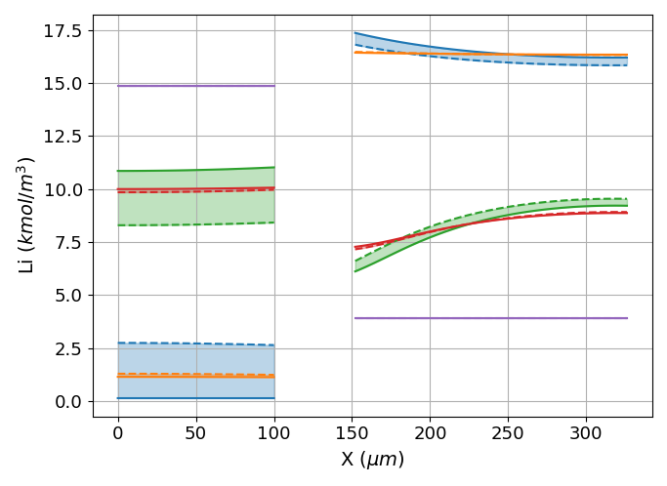
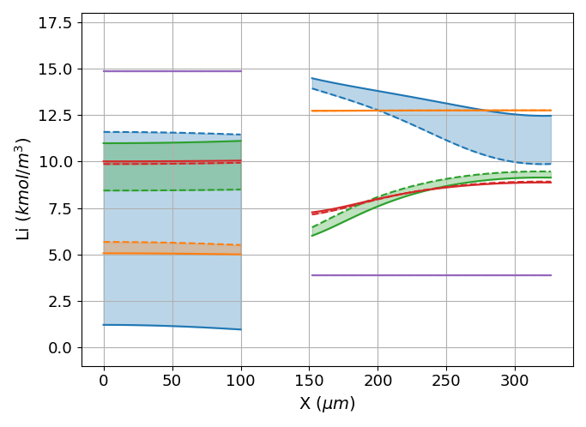
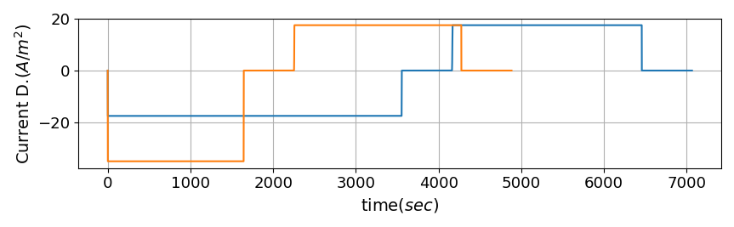
Discharging (1/2/3/4C) + Charging (1C)
Discharging = -1C
1Ca/4Ca
4.1
4Cd
1Cd
1Ca
1256 sec
4Ce
1Ce
1Cd
1Ce
4Cc
1627 sec
1Cc
1Cc
Center
1Cb
Surface
-1C
2032 sec
-2C
-3C
Discharging = -4C
-4C
4Cb
1Cb
2303 sec
4Ca
Charging =1C
Charging =1C
4Cd
Discharging = -1C
4Ce
Discharging = -2C
4Cc
4Cb
Center
During charging/discharging period, Li concentration distribution in the electrode particles widens as shown in the right figures.
Its distribution range shrinks in the relaxation period.
The expansion/shrinkage gets enhanced by increasing discharging rate from 1C to 4C.
At higher discharging rate, the discharging capacity is reduced as well as the charging capacity
The relaxation potential after discharge increases with discharging rate.
Surface

Slide 22
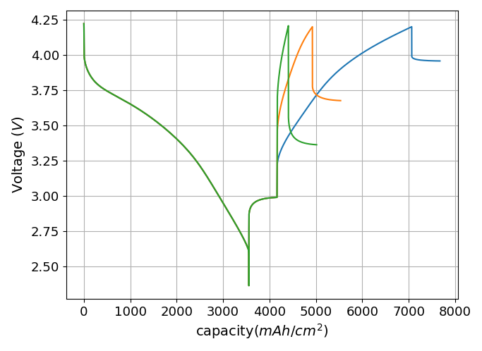
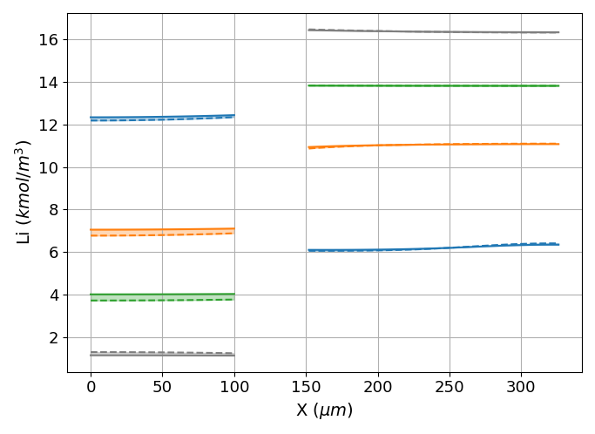
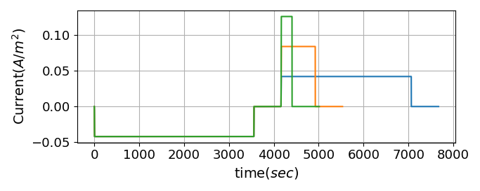
Discharging (1C) + Charging (1/2/3C)
4.2
1C_CH
2C_CH
1C_CH
3C_CH
2C_CH
1C_DCH
3C_CH
1C_DCH
246 sec
763 sec
The charging behavior is simulated at different charging rate.
At higher charging rate,
The cell reaches quickly the charging limit voltage (V_{max} = 4.2v) and the charging time is shortened.
But, the amount of Li ions having transferred from cathode to anode electrode is reduced as shown in the right figure.
The discharging capacity will be dwindled.
2908 sec

Slide 23
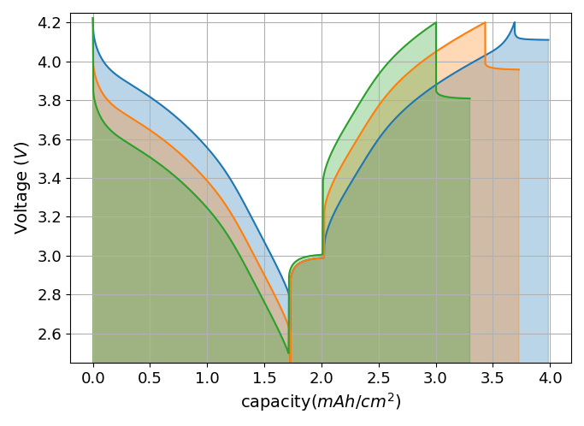
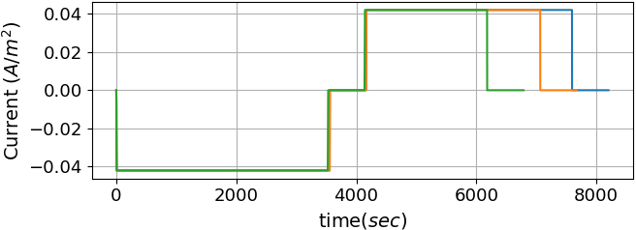
Effect of R_{SEI} (SEI resistance)
R_{SEI} (Ω⋅m²) =
0.0
0.1
0.2
The effect of SEI resistance on cell capacity is studied by simulation.
As the solid electrolyte film layer grows, cell’s internal resistance grows.
Cell voltage change at the start of discharge/charge increases with higher SEI resistivity.
As SEI resistivity increases, the time to reach charging limit voltage gets shorter and charging /discharging capacity is reduced..

Slide 24
Conclusion
Physics based Li-ion cell model is developed successfully.
The model is verified by comparison with test data.
Mass and charge transfer with electrochemical reactions are well analyzed.
The simulation model will be applied to analyzing cell performance issues such as capacity fade and impedance growth.
The simulation tool developed is able to deploy freely to other battery engineers

